Slide 1

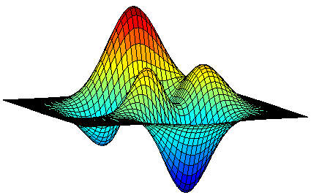
Submodular Maximization in the Big Data Era
Moran Feldman
The Open University of Israel
Based on
Greed Is Good: Near-Optimal Submodular Maximization via Greedy Optimization.
Feldman, Harshaw and Karbasi. COLT 2017.
Do Less, Get More: Streaming Submodular Maximization with Subsampling.
Feldman, Karbasi and Kazemi. NIPS 2018 (to appear).
Unconstrained Submodular Maximization with Constant Adaptive Complexity.
Chen, Feldman and Karbasi. Submitted for publication.

Slide 2

Combinatorial Optimization
max f(S)
s.t. S ⊆ N
S obeys a constraint C
Given a ground set N.
N is the set of edges of a graph.
The constraint C allows only legal matchings.
f(S) = |S| is the size of the set S.
Maximum Matching

Slide 3
Combinatorial Optimization
✗
✓
max f(S)
s.t. S ⊆ N
S obeys a constraint C
(x ∨ y ∨ z) ∧ (x ∨ z ∨ w)
S = {y, z}
➔ f(S) = 1
Given a CNF formula.
An element in N for every variable.
f(S) is the number of clauses satisfied by assigning 1 to the variables of S (and 0 to the other variables).
Max-SAT

Slide 4

An Interesting Special Case
max f(S)
s.t. S ⊆ N
S obeys a constraint C
Generalizes Maximum Independent Set
Cannot be approximated
Interesting to study special cases.
Should have the right amount of structure.

Slide 5
An Interesting Special Case
max f(S)
s.t. S ⊆ N
S obeys a constraint C
Well Known Example
The function f is linear.
C is defined by a totally unimodular matrix (a bit inaccurate).
Can be solved (exactly) efficiently.
Every extreme point solution is integral.
Every element in N has a weight.
f(S) is the sum of the weights of S’s elements.
A matrix is totally unimodular if the determinant of every square submatrix of it is either -1, 0 or 1.

Slide 6


An Interesting Special Case
max f(S)
s.t. S ⊆ N
S obeys a constraint C
In this Talk
Problems in which the objective function f is submodular.
What is a submodular function?
A class of functions
capturing
diminishing
returns

Slide 7


Why should We Care?
Diminishing returns (and thus, submodularity) appear everywhere.
Economics
Buying 100 apples is cheaper than buying them separately.
Sensor Covering
The more sensors there are, the less each one covers alone.
Notes:
Mention also about water pipes coverage.

Slide 8

Why should We Care?
Diminishing returns (and thus, submodularity) appear everywhere.
Σ
Summarization
Given a text, extract the a small set of sentences capturing most of the information.
Extract a small set of representative pictures from a video.
Combinatorics
For example, the cut function of a graph.

Slide 9
The Greedy Algorithm
So, how do we maximize submodular functions?
In practice, usually
just run
the greedy
algorithm.
The Greedy Algorithm
While more elements that can be added to the solution:
Pick among them the element increasing the value by the most.
Add it to the solution.

Slide 10
The Greedy Algorithm
Intuitively works because there are no synergies.
If an element is good as part of a group, then it is also good alone.
In 1978, proved to have a theoretical approximation guarantee in many cases.
[Fisher et al., 1978]
[Nemhauser and Wolsey, 1978]
[Nemhauser et al., 1978]
The Greedy Algorithm
While more elements that can be added to the solution:
Pick among them the element increasing the value by the most.
Add it to the solution.

Slide 11



More Recent History
Research on submodular maximization boomed in the last decade.
Enabled by theoretical breakthroughs.
Motivated by many new applications, especially in machine learning.
Better Guarantees
Better Approximations
More General Problems
Big Data Models
Streaming
Property Testing
Parallelism
  Map-Reduce
  Low Adaptivity
Doing it Faster
Less computation
Less objective evaluations

Slide 12

A Toy Problem
Maximize a non-negative submodular function
Maximize a linear function
Every element in N has a weight.
f(S) is the sum of the weights of S’s elements.
subject to a k-matchoid constraint.
subject to a matching constraint in a k-uniform hypergraph.
✗
✓

Slide 13


Back to Greedy
The Greedy Algorithm
Let M  ∅.
While there are edges that do not intersect any edge of M:
Pick among them the maximum weight edge.
Add it to M.
Analysis
Consider an iteration in which an edge e is added to M.
Guaranteed approximation ratio of k.
(
)
Gain
Damage
Decrease in the weight of OPT edges that can be added to M
= Increase in f(M)
= f(e)
=
≤ k ∙ f(e)

Slide 14
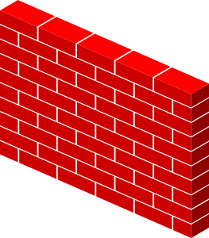
Back to Greedy
The Greedy Algorithm
Let M  ∅.
While there are edges that do not intersect any edge of M:
Pick among them the maximum weight edge.
Add it to M.
Performance
Linear functions
Guaranteed approx. ratio of k
Submodular functions
No guaranteed approx. ratio
Good performance in practice
Speed
The greedy algorithm is fast,
but not fast enough for Big Data.

Slide 15

Getting More Speed
Previous work suggested implementations for the greedy algorithm that are faster either
in practice [Minoux, 1978],
or in theory [Badanidiyuru and Vondrák, 2014].
Can we gain speed by modifying the greedy algorithm?
Sure, just remove a (random) part of the input.

Slide 16
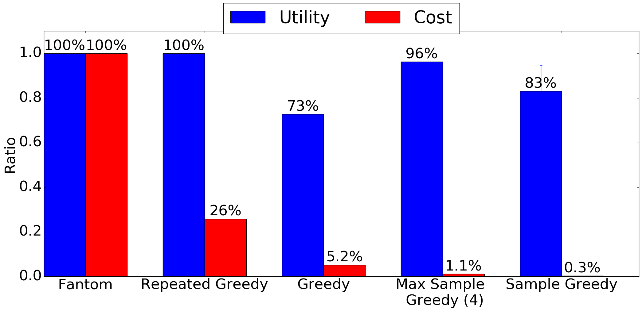
Experiment
Objective: suggest a diverse set of m films so that at most g of them belong to any particular genre out of the user’s favorite genres.
previous state of the art
new state of the art for det. algorithms
the suggested algorithm

Slide 17
Why does It Work?
Removing elements that do not belong to OPT is not a problem.
Removing elements of OPT is a problem only if greedy would have taken them otherwise.
Results
No loss for linear functions.
Now the algorithm has a guaranteed approximation ratio for submodular functions.
Take Home Message
Removing random parts of the input makes sense when accidently picking parts of OPT helps the algorithm.
Balance
each
other
Reminder
When adding every element e:
= Increase in the value of the solution.
= Decrease in the weight of OPT edges that can be added to the solution.
≤ k
If e is an OPT element:
=1

Slide 18


(Semi-)Streaming
A computational model for the case in which the input is too large to store in memory.
Extracting from a long surveillance video a set of frames representing the “action” taking place.
The edges of the hypergraph arrive one after the other.
We only allowed memory linear in the size of the maximum possible solution (up to poly-logarithmic terms).

Slide 19
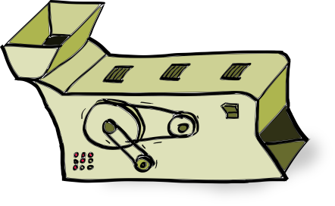
Local Search Algorithm
A natural algorithm for the problem is:
Start with an empty matching M.
Whenever an edge e arrives:
If it is beneficial to add e to M and remove all the edges intersecting it, do it.
Intuitive Problem
Adversary can make the algorithm change its solution in any desired way for a negligible gain.

Slide 20
Local Search Algorithm
We need the adversary to “pay” a significant price for changing the configuration.
Start with an empty matching M.
Whenever an edge e arrives:
Let NV(e, M) be the total value of edges in M intersecting e.
If f(e) ≥ 2 ∙ NV(e, M), then add e to M and remove the edges intersecting it.
Observation
The gain is now on the same order of magnitude as the values of the added and removed edges.

Slide 21




Our Contribution
Linear functions
Guaranteed approx. ratio of 4k [Chakrabarti and Kale (2014) and Chekuri et al. (2015)]
Improves when the algorithm takes many OPT elements
Submodular functions
No guaranteed approx. ratio
Same situation as with the greedy algorithm.
Natural to use the same “crazy” solution:
  Ignore (at random) some of the arriving elements.
Faster algorithm.
No loss in the guarantee for linear functions.
Approximation guarantee for general submodular functions.

Slide 22
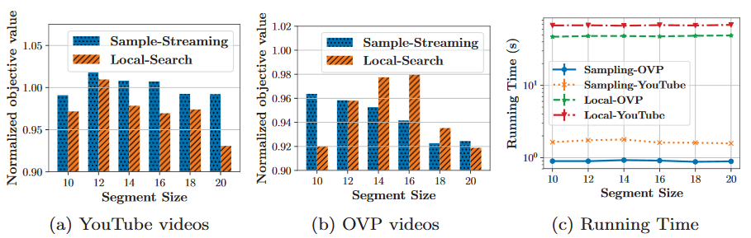

Experiment
Objective: given a video, extract a summery of k frames out of it which is as diverse as possible.
Sample Streaming: our algorithm
Local-Search: algorithm with the state of the art approximation guarantee. Not the algorithm discussed earlier.

Slide 23
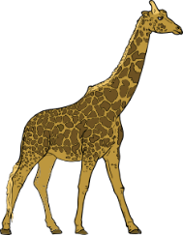

Adaptivity
Algorithms for submodular maximization evaluate the objective function many times.
In practice, these evaluations might be quite expensive.
Obvious Conclusion
Try to reduce number of evaluations.
Usually equivalent to making the alg. faster.
Other Option
Make the evaluations in parallel.
Problem: Most submodular optimization algorithms are inherently sequential.
Think about the greedy algorithm…

Slide 24


Adaptivity
Formal Model
The algorithm specifies the evaluations it wants in rounds (batches).
Each round can include a polynomial number of evaluations.
We want to keep the number of rounds small, so that the parallel execution time remains short.
Some History
Balkanski and Singer (2018) showed:
Algorithm for maximizing a monotone submodular function to subject to a cardinality constraint using O(log n) rounds.
Tight up to a O(log log n) factor.
Many very recent extensions: general submodular functions, more general constraints.
All inherit the impossibility result.

Slide 25
Our Contribution
Unconstrained submodular maximization
Given a submodular function f, find a set maximizing it.
Spoiler: Almost..
One can get (½ - ε)-approximation using Õ(ε⁻¹) rounds.
We plan to do experiments also.
Ignored by previous works.
An “ancient” algorithm achieving 1/3-approximation using a single round of adaptivity. [Feige et al. 2011]
Optimal Approximation is 1/2
Algorithm by Buchbinder et al. (2015).
Impossibility by Feige et al. (2011).
Our Question
Can one get the optimal ½-approximation using a constant number of rounds?
Notes:
Mention also the ¼ approximation.

Slide 26

Sequential Algorithm
Initially: X = ∅, Y = {u₁, u₂, …, u_{n}}.
For i = 1 to n do:
Add u_{i} to X with probability r_{i}. Otherwise, remove it from Y.
Return X (= Y).
Running example:
Y =
u₁
u₂
u₃
u₄
u₅
u₆
…
u_{n}
X =
u₁
u₃
u₄

Slide 27
Parallel Algorithm
Goal
We want to make decisions for many of the elements in parallel.
Problem: the probability r_{i} depends on the marginals of u_{i} (how much one can gain by adding it to X or removing it from Y).
Observation
The marginals are more likely to change if we make decisions for more elements.
There is a cutoff number.
The average marginal is likely to change for this number of decisions,
but not for fewer.

Slide 28
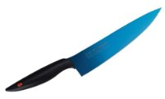
Cutoff
We make a decision for exactly this cutoff number of elements in every iteration.
Guarantees that every elements is chosen with (roughly) the right r_{i}.
How to find the cutoff?
Try an exponentially increasing series of values.
For every value, estimate by sampling.
Bounding the number of rounds
The marginals can only decrease (diminishing returns).
After every round the average marginal is likely to decrease.
After a few rounds, the marginals are so low, allowing us to make all the remaining decisions in parallel.

Slide 29
Questions
?
?
?
?
?

Slide 30

Analysis of the Local Search Alg.
Let S be the set maintained by the algorithm and A be the set of elements that have ever been in S.
Observation 1
f(A) ≤ 2 ּ∙ f(S)
Why?
The increase in f(S) is f(e) - NV(e, M) ≥ ½ ∙ ּּf(e).
The increase in f(A) is f(e).
Observation 2
f(OPT \ A) ≤ 2k ּ∙ f(A \ OPT)
Start with an empty matching M.
Whenever an edge e arrives:
Let NV(e, M) be the total value of edges in M intersecting e.
If f(e) ≥ 2 ∙ NV(e, M), add e to M and remove edges intersecting it.

Slide 31

Explaining the Observation
Observation 2
f(OPT \ A) ≤ 2k ּ∙ f(A \ OPT)
Every edge OPT \ A can be charged to the edges preventing its inclusion in the solution.
Every edge of A \ OPT is charged at most twice its cost each time and at most k times.

Slide 32
Analysis of the Local Search Alg.
Let S be the set maintained by the algorithm and A be the set of elements that have ever been in S.
Observation 1
f(A) ≤ 2 ּ∙ f(S)
Observation 2
f(OPT \ A) ≤ 2k ּ∙ f(A \ OPT)
f(OPT) ≤ 2k ∙ f(A) ≤ 4k ∙ f(S) Guaranteed 4k-approximation
Remarks
The inequality f(OPT) ≤ 2k ∙ f(OPT) is derived from Observation 2, and is not tight when many OPT elements are in A.
The original proof (for the more general constraint) is much more involved.

